Slide 1
Settling Texas and Growing Tensions
Standard 8.8.5: Discuss Mexican settlements and their locations, culture, stance on slavery, and land grant system.

Slide 2
Learning Objective
We will understand why American’s settled in Texas and how tensions developed between American settlers and the Mexican Government.

Slide 3
First Settlers
In 1819 most of Texas’s 3,000 residents were Tejanos or Mexicans who claimed Texas as home.
Spain offered large land grants to promote Texas’s growth, but Mexico would declare its independence from Spain in 1821.
Moses Austin received the first land grant in 1821, but died before he could set up his colony.

Slide 4
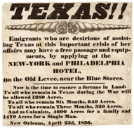
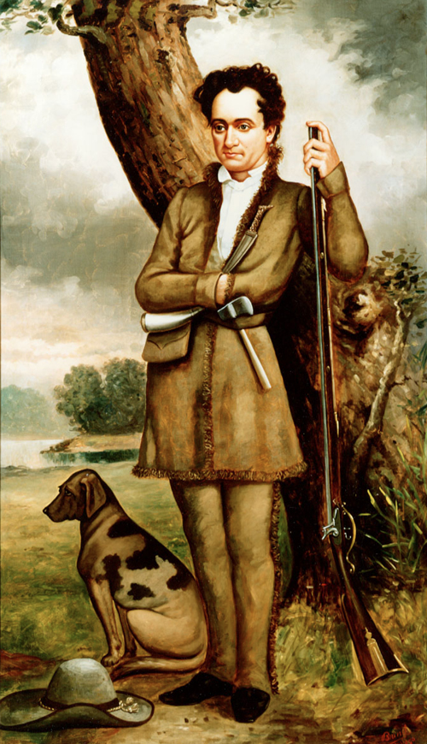
First Settlers Cont.
Moses Austin’s son Stephen F. Austin recruited 300 American families to settle the fertile land along the Brazos and Colorado rivers in Texas.
Austin became the leader of settlers in Texas.
Davy Crockett left Tennessee after losing his seat in Congress and headed to Texas for a fresh start in 1835.

Slide 5
Growing Tensions
By 1830 American settlers outnumbered Mexicans and had not adopted Mexican ways.
In 1830 Mexico issued a Decree, that stopped all immigration from the U.S.
A tax was placed on American goods entering Texas.
Texans depended on slaves to farm and many feared that Mexico would end slavery in Texas.
In 1833 Mexican President, General Antonio Lopez de Santa Anna, removed the ban on American settlers, but did not change Texas’s political status.

