Slide 1
Middle & New Kingdoms
Learning Objectives:
Students will understand the significance of Queen Hatshepsut and Ramses the Great.
Students will describe the role of Egyptian trade in the middle East.

Slide 2
Middle Kingdom
Pharaohs of the old kingdom lost control around 2300 B.C.E.
200 years later a new dynasty of Pharaohs rose up creating the Middle kingdom.
The capital city was moved from Memphis under the Old Kingdom to Thebes.
During the time of peace and prosperity of the Middle Kingdom the arts, literature, and architecture thrived.

Slide 3
Middle Kingdom
The Middle Kingdom ended in 1670 B.C.E. when the Hyksos attacked.
The Hyksos were great warriors and used advanced weaponry.
Horse drawn chariots
Bronze and iron weapons
The Egyptians who fought on foot with copper and stone weapons were no match for the Hyksos.

Slide 4
New Kingdom
After 120 years of the Hyksos ruling over Egypt a young prince Ahmose led an uprising that pushed the Hyksos out of Egypt.
Ahmose’s reign began the New Kingdom.

Slide 5
Focus Check
During the Middle Kingdom what aspects of the Egyptian civilization thrived?
Why were the Egyptians not able to defeat the Hyksos when they invaded?

Slide 6
New Kingdom
Hatshepsut came to power and named herself Pharaoh.
She was the first of only a few queens to rule over Egypt.
Hatshepsut was more interested in trade than conquest.
http://www.pbs.org/empires/egypt/newkingdom/hatshepsut.html

Slide 7
New Kingdom
After Hatshepsut’s death her nephew Thutmose III became pharaoh.
Thutmose conquered more lands and Egypt grew wealthier from tributes.
Slavery was common during this time.
http://www.pbs.org/empires/egypt/newkingdom/tuthmosis3.html

Slide 8
Focus Check
How was Hatshepsut unlike other pharaohs? (2 reasons)
Since slavery became common what three rights were slaves granted?

Slide 9
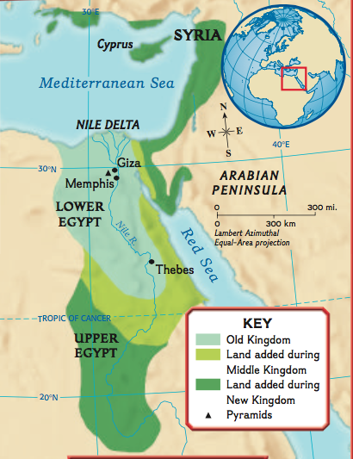

Slide 10
New Kingdom
Amenhotep came to power and realized that priests were gaining too much power.
With the help from his wife Nefertiti, Amenhotep attempted to lead Egypt into a new religion.
Amenhotep created a monotheistic religion to maintain his power as Pharaoh.
The one god was Aton
Unfortunately most Egyptians did not agree with Akhenaton (Amenhotep) and he allowed the Hittites to attack.

Slide 11
End of The New Kingdom
Ramses II was one of the most effective pharaohs of the New Kingdome ruling for 66 years.
Many temples were built as Ramses had the empire rebuilt.
Most Egyptians prayed at home so the temples became houses for the gods and acted as banks.
http://www.pbs.org/empires/egypt/newkingdom/architecture.html

Slide 12
End of The New Kingdom
After Ramses’ rule, Egypt’s power began to decline.
Egypt was attacked by neighboring civilizations and eventually only controlled the Nile Delta region.
By 900 B.C.E. Egyptians were ruled by the Libyans, then the Kush, and lastly the Assyrians.

Slide 13
Focus Check
Why was Amenhotep not a successful leader?
What purposes did the temples serve?

