Slide 1
Early Greeks
Learning Objective: We will analyze the geography of Greece and understand how that affected the Greek civilization and led to the creation of city-states.

Slide 2
Geography
Mainland Greece is a mountainous peninsula.
The Ionian Sea is to the west of Greece, the Aegean Sea is to the east, and Mediterranean Sea is to the south.
There are over 2,000 islands in Greece, Crete is the largest.
No major rivers on Greek mainland, but they were able to grow wheat, barley, olives, and grapes in their rocky soil due to the favorable climate.

Slide 3
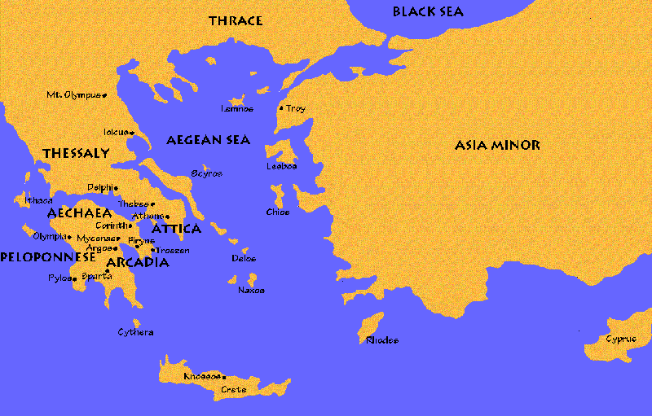
Geography

Slide 4
Geography

Slide 5
The Minoans
The ruins of the Minoan civilization, the first civilization in Greece, are on the island of Crete.
The Minoan people were traders, traveling by ship to trade with other countries.
The Minoan civilization collapsed around 1450 B.C.E., although historians disagree on the cause of the Minoan destruction.
Artifacts at the Palace at Knossos reveal the riches of the Minoan people, such as wine, oil, jewelry, statues, and an advanced sewer system.

Slide 6
Minoans Palace

Slide 7
Minoan Myth
http://project-history.blogspot.com/2005/12/mythology-and-ancient-minoans.html

Slide 8
Atlantis
Conduct some research to find out about the lost city of Atlantis.

