Slide 1
Early Israelites
Learning Objectives:
Students will describe the origins and significance of the first monotheistic religion of Judaism and its moral laws for humanity.
Students will identify and discuss the locations and settlements of the Hebrew people including the Exodus and its significance.

Slide 2
Origins of the Israelites
The Israelites built a kingdom in Canaan.
They believed in one god which is called monotheism.
The Israelite faith became the religion of Judaism.
Judaism influenced Christianity and Islam.
Israelites spoke Hebrew and recorded their history in what later became the Hebrew Bible.

Slide 3
Origins of the Israelites
Israelites believed they were descendants from a man named Abraham.
It is believed that God told Abraham to settle in Canaan and worship the one true God.

Slide 4
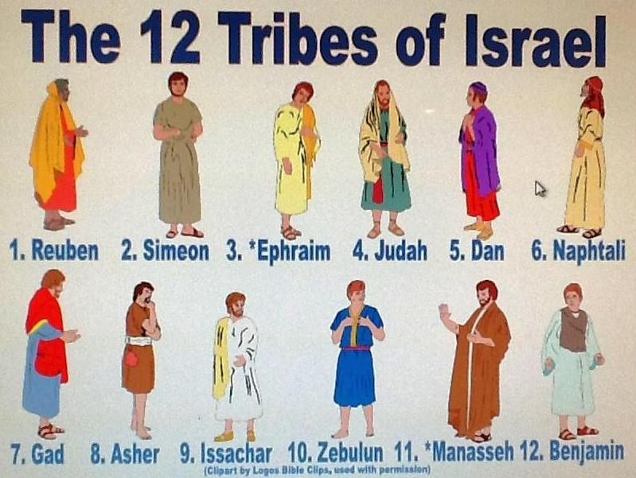
Origins of the Israelites
Abraham’s grandson named Jacob raised 12 sons.
Their families became the 12 tribes of Israel.
After 100 years in Canaan the Israelites suffered a long drought.
To survive the Israelites migrated to Egypt.

Slide 5
Origins of the Israelites
The Egyptian pharaoh enslaved the Israelites.
To prevent a rebellion the pharaoh ordered all Israelite baby boys to be killed.
The pharaoh’s daughter found Moses.

Slide 6
Origins of the Israelites
God sent 10 plagues to trouble Egypt.
The last plague killed all first born children except for the Israelites’ who marked their doors with lamb’s blood.
This convinced the pharaoh to allow the Israelites to leave Egypt.
The pharaoh changed his mind and sent his soldier to bring back the Israelites.

Slide 7
Origins of the Israelites
With God’s help Moses parted the Red Sea for the Israelites to escape.
The Egyptians in pursuit were drowned as the Red Sea was un-parted once the Israelites had crossed.

Slide 8
Origins of the Israelites
On their way back to Canaan Moses went to the top of Mount Sinai and received laws from God.
These laws were known as the Ten Commandments.
The Ten Commandments are what God believes to be right and wrong.
These commandments helped shape the basic moral laws of many nations.

Slide 9
The Promised Land
It took the Israelites about 40 years to reach Canaan.
Moses died along the way and Joshua took over.
When they reached Canaan, they found the Canaanites living there.
The Israelites thought it was God’s will to conquer the Canaanites and Joshua led the them into battle.

Slide 10
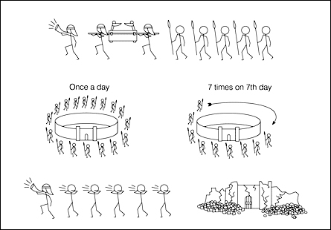
The Promised Land
The Israelites marched around the walls of Jericho for seven days.
On that seventh day the Israelites let out a great shout and the walls of Jericho came crumbling down.

Slide 11
The Promised Land
Joshua would lead the Israelites into three more wars.
The land they seized was divided amongst the 12 tribes of Israel.
After Joshua’s death the Israelites looked to Judges for leadership.
Judges were usually military leaders who led 1-2 tribes.
The Phoenicians were a group of Canaanites who developed and alphabet.
An alphabet is a group of letters that stand for sounds.

