Slide 1
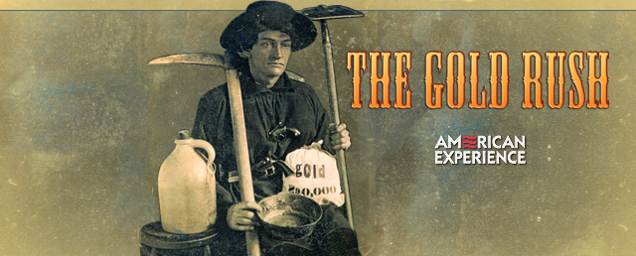
The California Gold Rush
Notes:
The audience intended for this power point lesson is 3rd grade students studying the history of California. I intend to cover the following; where and when the gold rush took place, what types of transportation were used, how gold was retrieved, one key figure during the gold rush, and the positive and negative effects of the gold rush.
The instructional goals of this presentation are for the students to describe and name the major events and factors of the California gold rush.

Slide 2
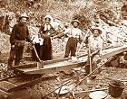
January 24, 1848
The California gold rush began when gold was discovered at Sutter’s Mill.
As the news of discovery spread, some 300,000 people came to California from the rest of the United States, Europe, and China increasing immigrant populations.

Slide 3
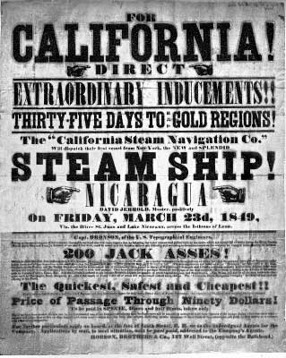
Click here to view a treasure map and see the destinations of the 49ers
These early gold
seekers called “49ers”
traveled to California by
sailing ships and
covered wagons across
the continent.

Slide 4
Journey by land
Please click on the link above. When you get to the website click on Part 1, and then “Journey by land.”
Read the page and in small groups answer and discuss the questions to the right.
What were the names of the major trails taken?
How long did the overland trip typically take? How far would they travel in one day?
What were two landmarks passed by the travelers?
What was the cost for a family of four?
What supplies might they have taken?

Slide 5
Journey by sea
Please click on the link above. When you get to the website click on Part 1, and then “Journey by sea.”
Read the page and in small groups answer and discuss the questions to the right.
What was the cost per person to travel by sea?
What were some changes made to cargo ships to transport passengers?
What were some supplies they might have taken?
What were some problems with these supplies?
What were some diseases common to the Panama route?

Slide 6
Gold Rush Video
Who discovered the first gold nugget?
Why were the gold seekers called “49ers?”
What were some reasons that most prospectors did not strike it rich?
How long did the California gold rush last?
What was the total amount in dollars found in gold after the gold rush was over?
Answer the following
questions based on the
video clip we watch in class.

Slide 7
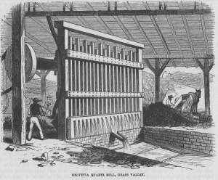
Techniques for retrieving gold
At first a technique called panning was used to retrieve gold from streams and riverbeds.
Hydraulic mining was later invented in California. This technique was created for larger scale gold mining

Slide 8
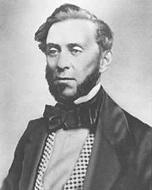
Samuel Brannan
Samuel Brannan was the first millionaire because of the California gold rush
Brannan established the first newspaper in San Francisco called the California Star and also established the first school in San Francisco
Brannan was elected to the California State Senate in 1853. He was also credited with developing banks, railroads, and telegraph companies.
To learn more about Samuel Brannan click here

Slide 9
The negative effects of the gold rush
Native Americans
became the victims of
disease, starvation, and
genocidal attacks.
The Native American population in 1845 was 150,000
The Native American population in 1870 was less than 30,000.
Many people that
journeyed to California
from around the world
never made it.
The Donner party- A total of 87 people from various families set out for California and became snowbound in the Sierra Nevada. Only 48 of the original 87 pioneers survived.
To read the Donner party journals and learn more about their journey click here

Slide 10
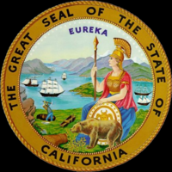
The positive effects of the gold rush
Towns and cities were charted
Roads, schools, and churches were formed
Improved transportation between California and the east coast
All of these
developments led to the
statehood of California
on September 9th, 1850
as the 31st state.

